Slide 1
Clock Based Gravitational Wave Detection

Slide 2
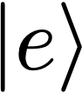
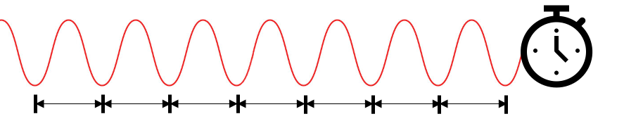
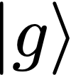
Atomic clocks

Slide 3
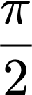
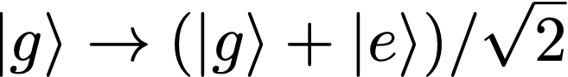
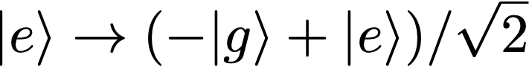
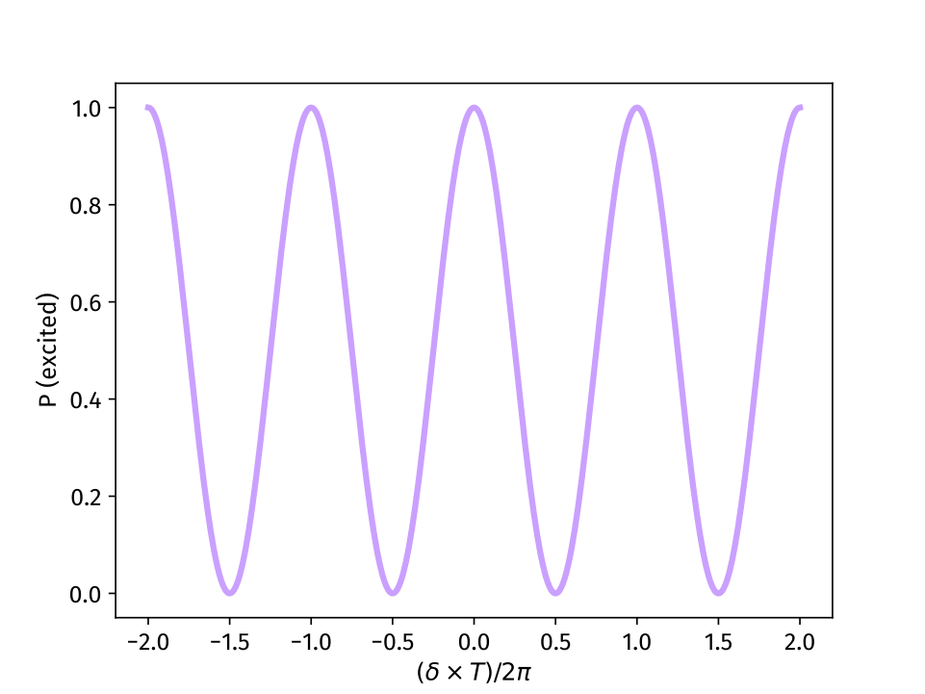
Ramsey interferometry
T
If laser is coherent over time T, we get clean Ramsey fringes
Used for ultra-low frequency feedback to clock laser
Longer T = better frequency sensitivity

Slide 4
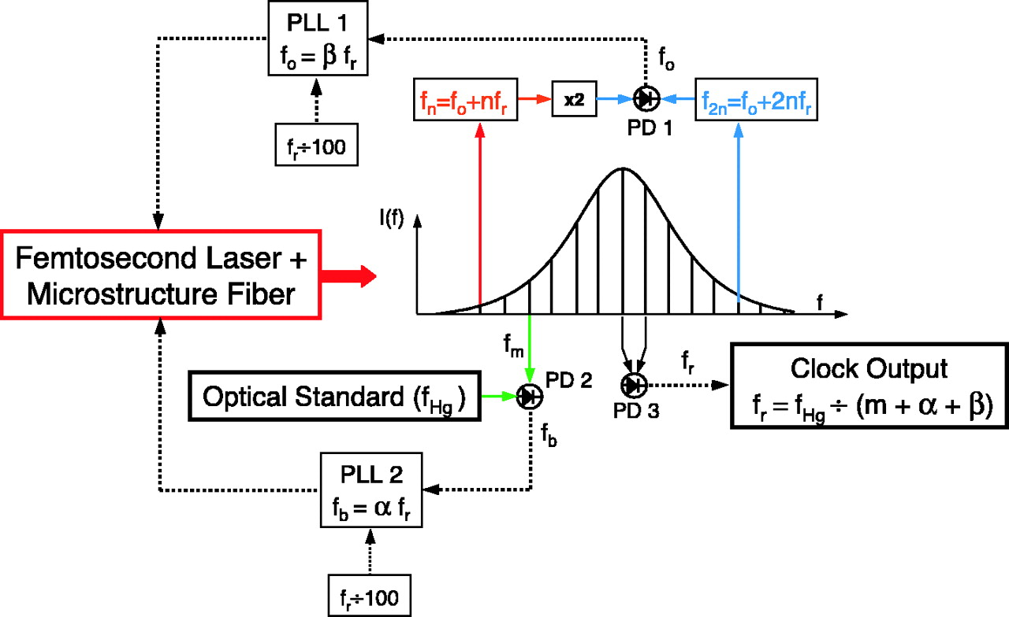
Typical clock operation
Optical frequency combs used to down-convert optical to microwave frequencies
S. A. Diddams et al Science 293,825-828(2001)

Slide 5
Differential clock comparisons with ⁸⁷Sr

Slide 6
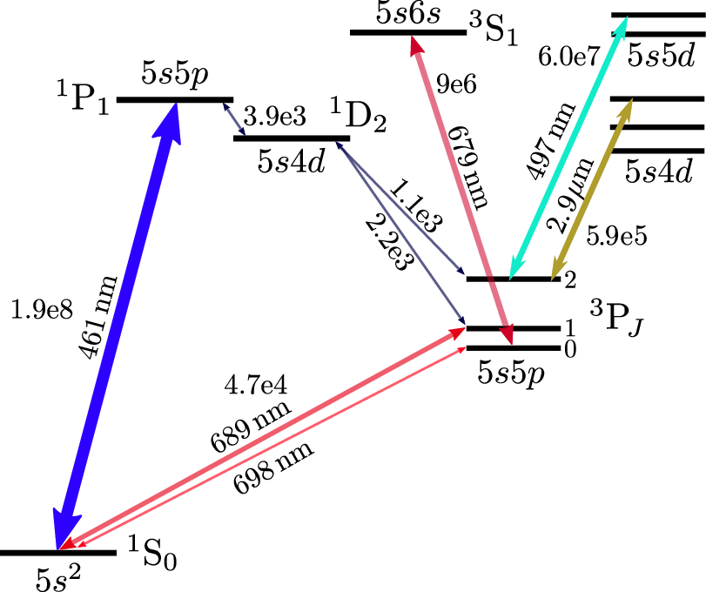
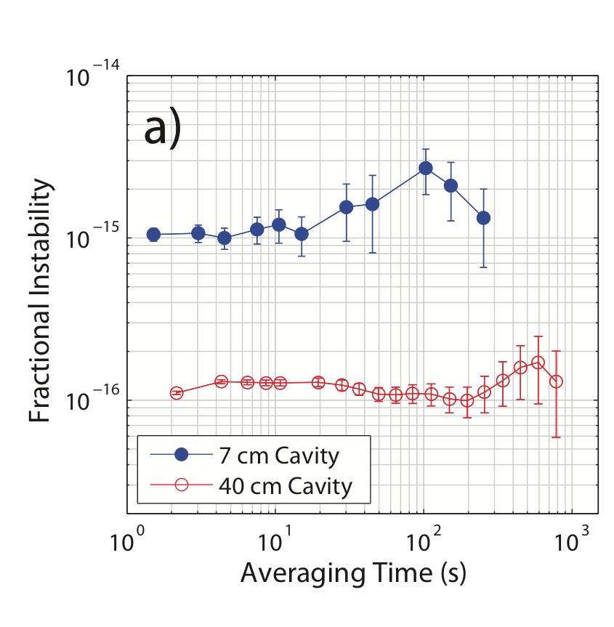
Sr term diagram
In order to use ⁸⁷Sr as an optical clock, we need an extremely stable 698 nm laser. The coherence time of the laser sets an upper limit to Ramsey interrogation
doubly forbidden transition, weakly allowed through nuclear spin in ⁸⁷Sr
Bowden, W., Hobson, R., Hill, I.R. et al., 2019
Current state of the art from Jun Ye’s group at JILA ~ 30 mHz

Slide 7
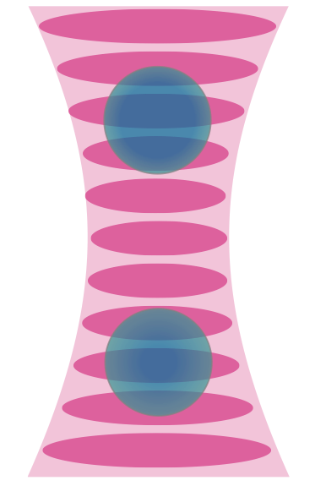
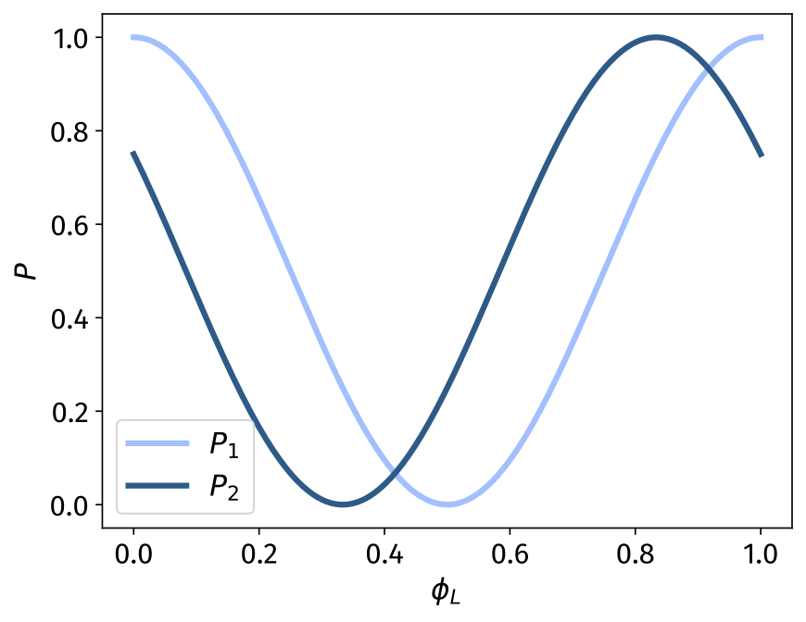
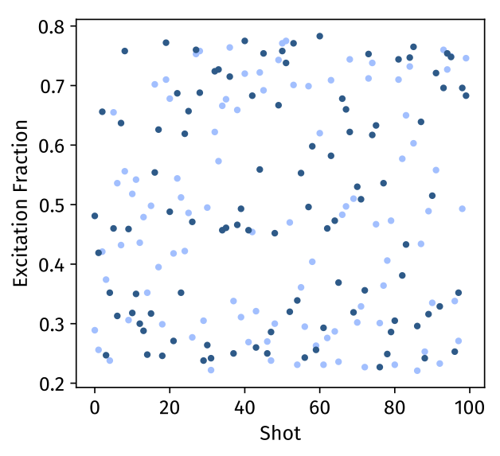
Differential measurements
813 nm lattice
Measurements beyond laser coherence time
698 nm clock laser

Slide 8
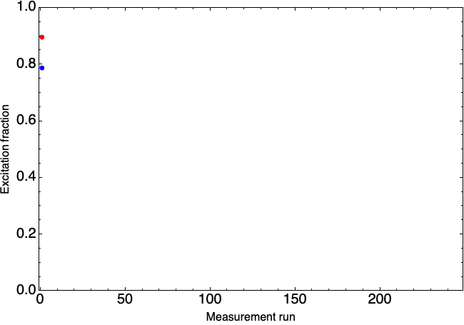
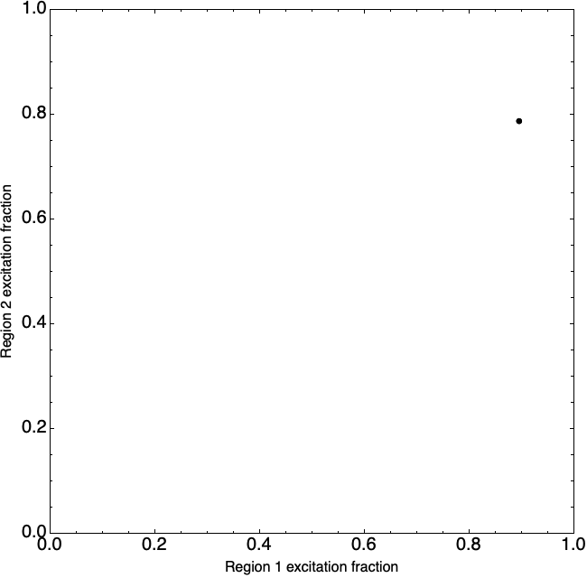
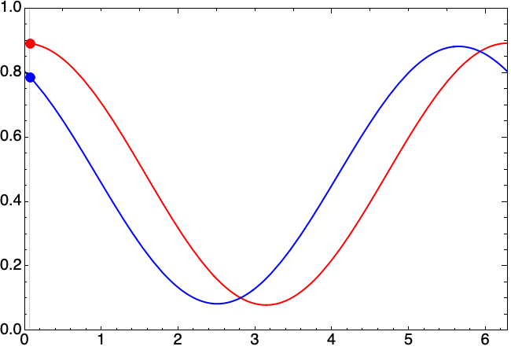
Differential measurements

Slide 9
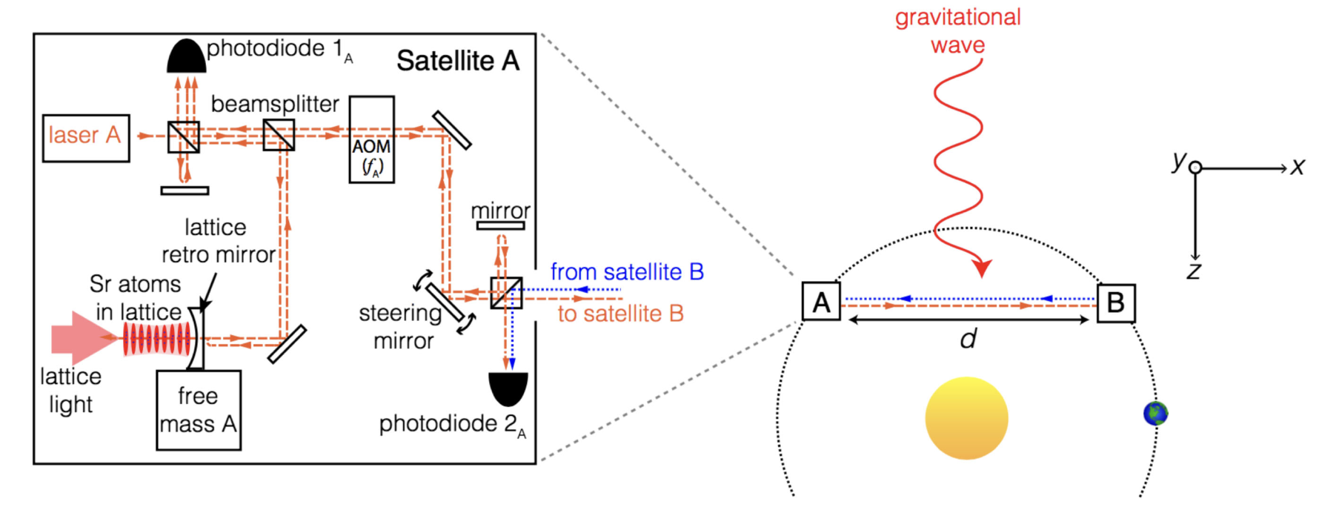
GW Detection
Kolkowitz et. al. PRD 2016

Slide 10
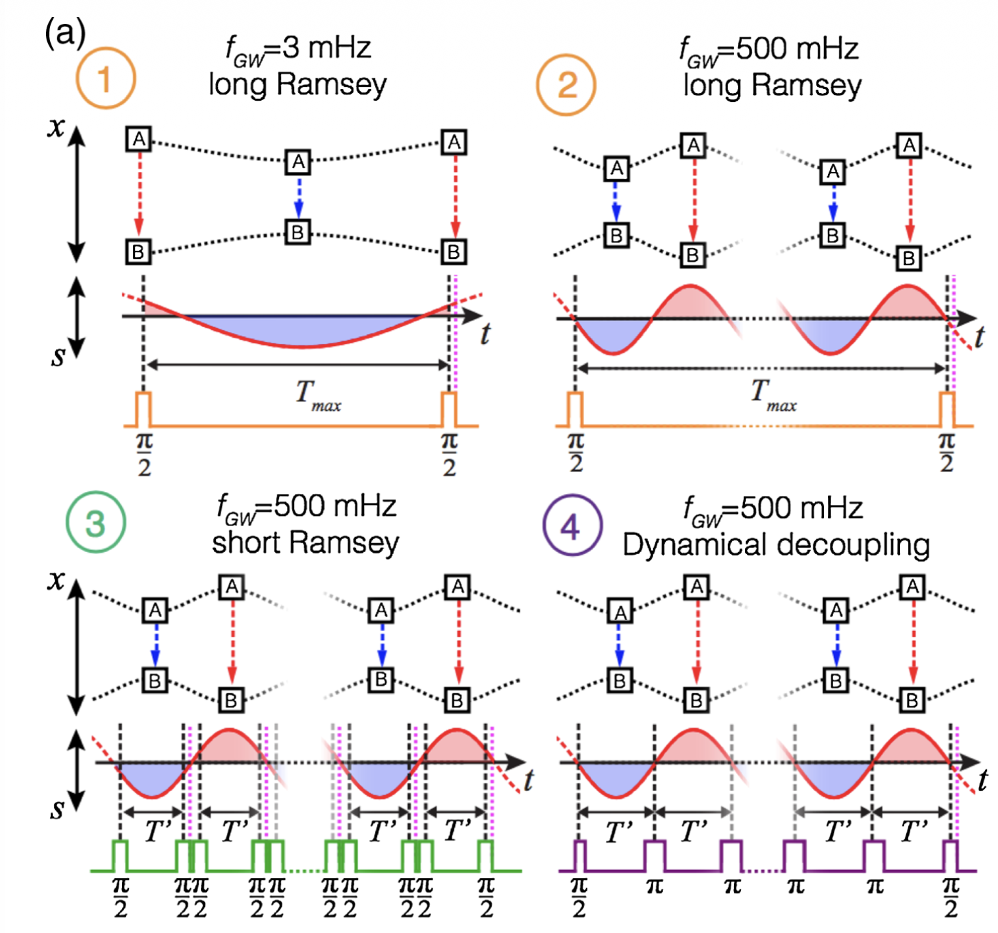
Doppler Tracking
Frequency difference due to the doppler shift induced by gravitational wave is averaged over measurement time
Dynamical Decoupling allows to add phase from every cycle by flipping the sign of the measured frequency

Slide 11
Signal strength
d = 10¹⁰ m

Slide 12
Detector Noise Sources
Quantum projection noise due to the binomial distribution of a finite number of atoms on measurement.
More atoms = Less Noise.
Averages down as 1/sqrt(t)
Residual laser noise from the control loop that locks the two lasers.
More photons = Less noise.
Averages down as 1/sqrt(t) when uncorrelated between measurements, 1/t when correlated

Slide 13
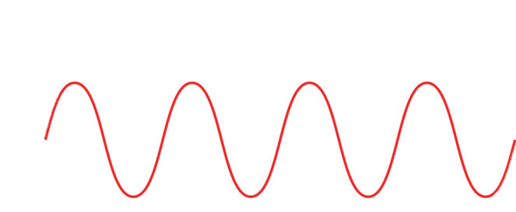
Frequency Estimation
N = 1e7
h =1e-20
Laser Noise : 1 mHz linewidth, 0.1 nW at PLL
T = 5s

Slide 14
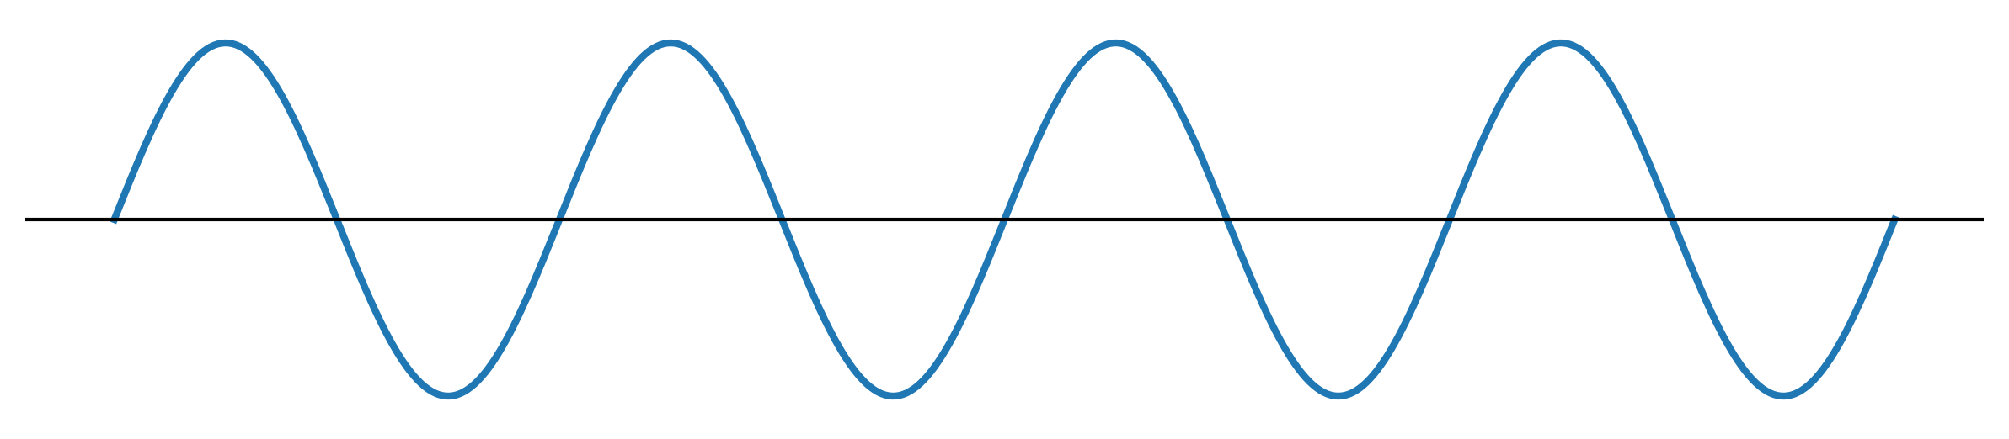
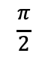
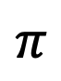
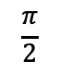
Phase Estimation
$$\frac{π}{2}$$
$$π$$
$$\frac{π}{2}$$
t₀

Slide 15
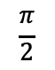
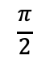
t₀
$$\frac{π}{2}$$
$$π$$
$$\frac{π}{2}$$
t

Slide 16
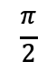
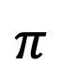
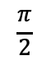
t₀
$$\frac{π}{2}$$
$$π$$
$$\frac{π}{2}$$

Slide 17
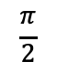
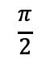
t₀
$$\frac{π}{2}$$
$$π$$
$$\frac{π}{2}$$

Slide 18
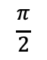
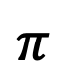
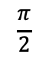
t₀
$$\frac{π}{2}$$
$$π$$
$$\frac{π}{2}$$

Slide 19
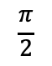
t₀
$$\frac{π}{2}$$
$$π$$
$$\frac{π}{2}$$

Slide 20
t₀

Slide 21
Phase Estimation
T = 160 s
f = 1/160 Hz
h = 1e-20
Measurement sequence = DD starting at different time points
No clear difference between more points vs more averages

Slide 23
Estimated error smaller than true error at low averaging times (probably because of laser noise)

Slide 24
Measurement offset largely inconsequential

Slide 25
Geometry
L
ɩ
e’_{y}
Ψ
e’_{x}
e_{y}
z
e_{x}
θ
y
ɸ
x

Slide 26
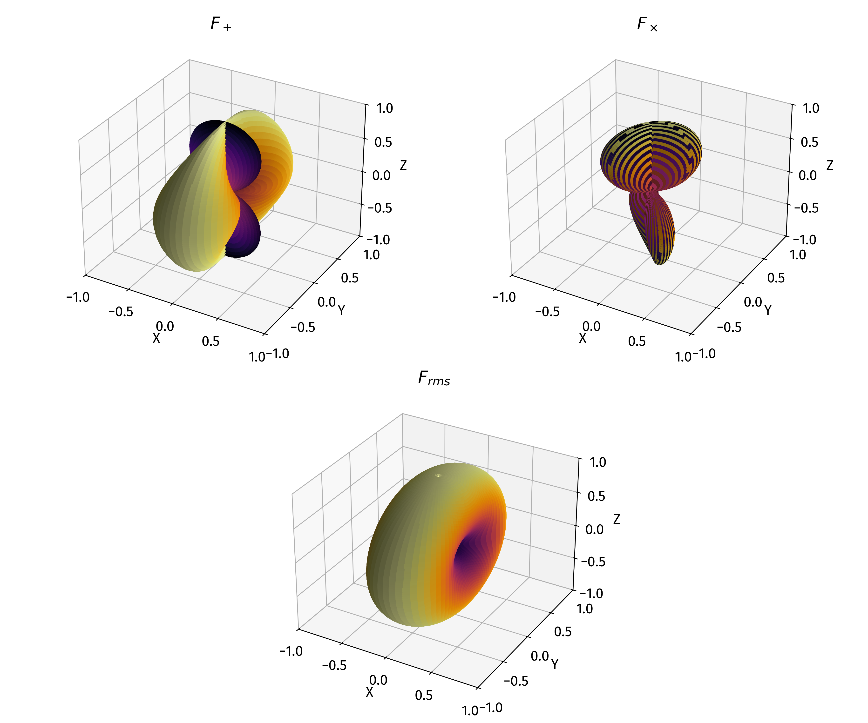
Antenna Patterns

Slide 27
First Attempts at Localization
Three detectors in heliocentric (circular) orbit @0, 30, 60 degree orientations.
Same noise floors, only assume + polarization with psi = 0 for the sake of simplicity

Slide 33
What next?
Is the phase/amplitude estimation optimal?
Best detector configuration? With n satellites, we technically have ^{n}C₂ detectors.
How to start dealing with more polarizations? We technically get N phases and amplitudes but there are many degeneracies due to the phase wrap around in time delay
I need better data analysis than what chatGPT gives me

Slide 34
More open questions
Most compelling science goals to inform choice of detector parameters.
How to deal with chirping signals? Can’t use the current estimation protocols.
Start plugging in realistic numbers for h₊ ,h_{x}

